Slide 1
First Steps with TensorFlow
Explore ML

Slide 2

What is TensorFlow?
Notes:
Image
Answer on next slide but allow learners to share prior knowledge.

Slide 3
TensorFlow is a free and open-source software library for dataflow and differentiable programming
It is a symbolic math library, and can be used for machine learning applications such as neural networks.
Notes:
TensorFlow is not a new programming language. It's a library which means it can be used within your existing code. The purpose of the library is to make it easier to implement common mathematical functions from linear algebra and calculus.
Rather than have all data flow through a single algorithm, TensorFlow can process the data in parallel. This is essential for setting up a neural network with multiple nodes and layers.
Image from https://www.tensorflow.org/guide/graphs

Slide 4
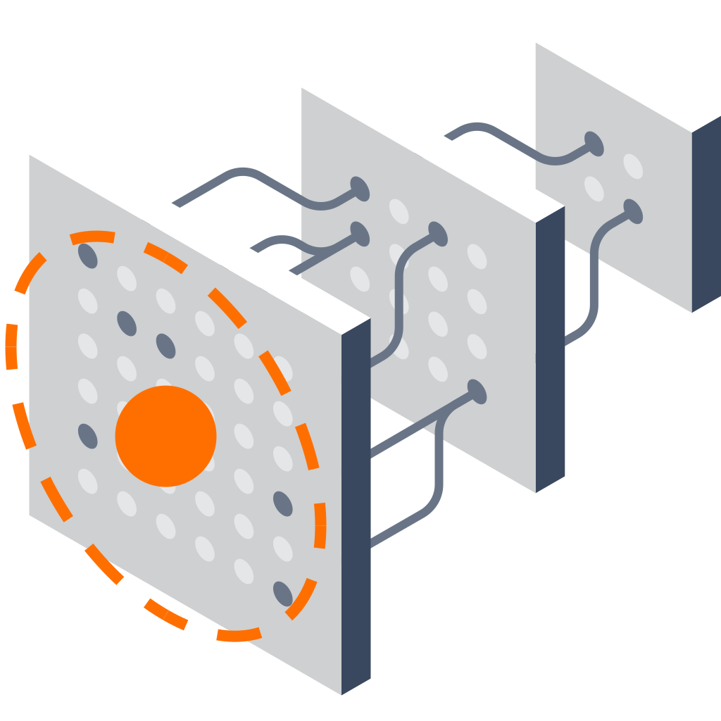

Why TensorFlow?
Notes:
There are 3 reasons why we using TensorFlow for this course:
First one is Flexible,
TensorFlow works in general computational infrastructure and works well for Deep Learning.
Deep Learning is a set of libraries on top of the core
Also useful for other machine learning algorithms, maybe even more traditional high performance computing (HPC) work
Abstracts away the underlying devices
Portable
Runs on many platforms
Data Center
CPUs and GPUs
Mobile phones
It’s open source!
First two images are from TensorFlow.org
Open Source Image recreated from Public Domain version

Slide 5
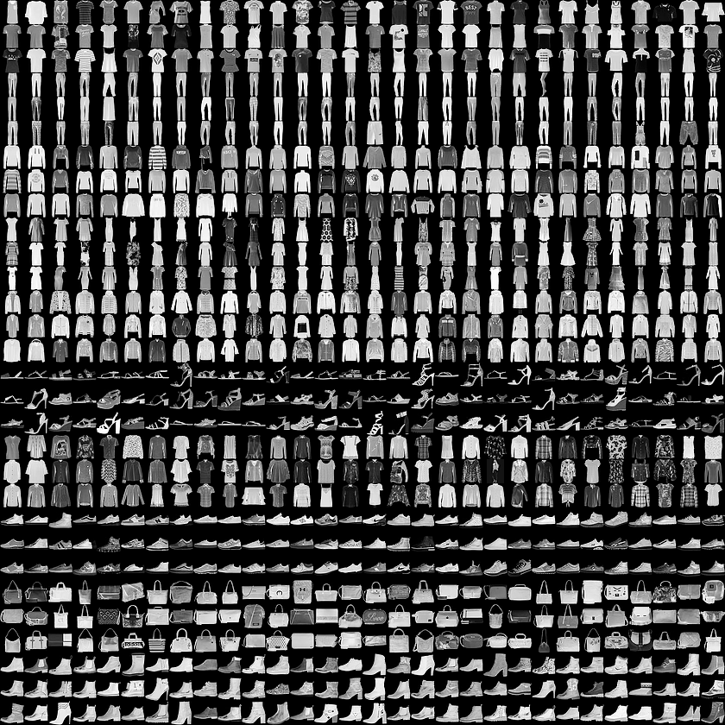
Today, we will try to create a neural network model to classify images of clothing, like sneakers and shirts.
Notes:
Fashion MNIST dataset which contains 70,000 grayscale images in 10 categories. The images show individual articles of clothing at low resolution (28 by 28 pixels)
Fashion MNIST is intended as a drop-in replacement for the classic MNIST dataset—often used as the "Hello, World" of machine learning programs for computer vision. The MNIST dataset contains images of handwritten digits (0, 1, 2, etc) in an identical format to the articles of clothing we'll use here.
This guide uses Fashion MNIST for variety, and because it's a slightly more challenging problem than regular MNIST. Both datasets are relatively small and are used to verify that an algorithm works as expected. They're good starting points to test and debug code.
We will use 60,000 images to train the network and 10,000 images to evaluate how accurately the network learned to classify images. You can access the Fashion MNIST directly from TensorFlow, just import and load the data.
Image from https://github.com/zalandoresearch/fashion-mnist The MIT License (MIT) Copyright © [2017] Zalando SE

Slide 6

Image Classification Coding Activity
https://www.tensorflow.org/tutorials/keras/basic_classification
Open the exercise in Colab
Sign in with your Google account
Activate the Runtime
Run code
Notes:
Let’s jump into the code!
Go to the exercise notebook
Open the exercise in Colab, a browser based notebook for running code in the cloud without needing to setup your computer.
Sign into your Google account (if it is their own account they can save the notebook in Drive to refer to later)
Activate the cloud-based runtime so you can run code in the cloud rather than setting up your machine
Run the code in a cell by clicking on the play/triangle button.

Slide 7
STOP
Do not present the following slides as a lecture.
They are for questions or a debrief after the activity.
Let learners work through the activity in pairs.

Slide 8
Import all Libraries
from __future__ import absolute_import, division, print_function
# TensorFlow and tf.keras
import tensorflow as tf
from tensorflow import keras
# Helper libraries
import numpy as np
import matplotlib.pyplot as plt

Slide 9


Notes:
In this exercise, we will use TF.Keras, a high-level API to build and train models in TensorFlow.
Tf.keras is TensorFlow's implementation of the Keras API specification. This is a high-level API to build and train models that includes first-class support for TensorFlow-specific functionality.
tf.keras makes TensorFlow easier to use without sacrificing flexibility and performance.

Slide 10
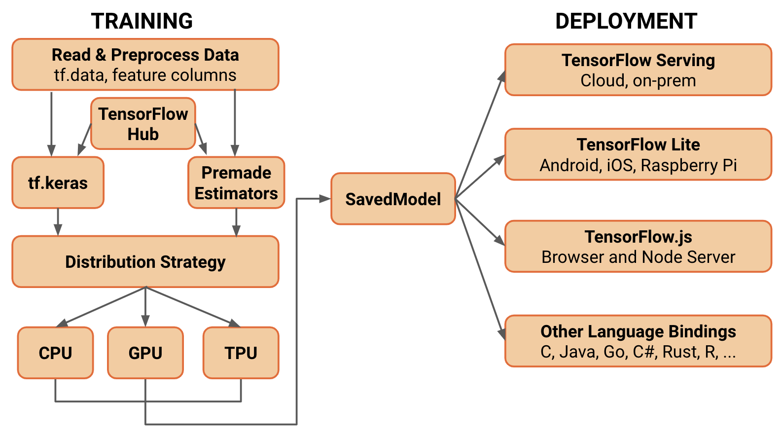
TensorFlow 2.0 Architecture
Notes:
Can note that there are other high-level TF API’s as well, including Keras. The ones shown here are encouraged for wide use if only because supporting a small number of API’s will enable better level of support, development and integration.
What should people use when? The guiding principle is the use of the highest level of abstraction that solves the problem at hand. All levels of abstraction are robust and worthy of productionisation and large scale use.
The higher levels of abstraction are easier to use but are also by design less flexible. It is recommended to start with the highest level of API first and get everything working. If additional flexibility is needed for some special modelling concerns that’s the time to move one level lower. Note that these libraries are built in a scaffolding way, popping down should be reasonably straightforward.
Image by Google's TensorFlow Team https://medium.com/tensorflow/whats-coming-in-tensorflow-2-0-d3663832e9b8

Slide 11
Import the Fashion MNIST dataset
fashion_mnist =
Keras.datasets.fashion_mnist (train_images, train_labels),(test_images, test_labels) =
fashion_mnist.load_data()
Notes:
What do you think the code in the white box is for?
It’s loading the dataset returns four NumPy arrays:
The train_images and train_labels arrays are the training set—the data the model uses to learn.
The model is tested against the test set, the test_images, and test_labels arrays.
Image from https://github.com/zalandoresearch/fashion-mnist The MIT License (MIT) Copyright © [2017] Zalando SE

Slide 12
Add Labels
Label | Class
0 | T-shirt/top
1 | Trouser
2 | Pullover
3 | Dress
4 | Coat
5 | Sandal
Label | Class
6 | Shirt
7 | Sneaker
8 | Bag
9 | Ankle boot
Notes:
The images are 28x28 NumPy arrays, with pixel values ranging between 0 and 255. The labels are an array of integers, ranging from 0 to 9. These correspond to the class of clothing the image.

Slide 13
Add Labels
class_names = ['T-shirt/top', 'Trouser', 'Pullover',
'Dress', 'Coat', 'Sandal', 'Shirt',
'Sneaker', 'Bag', 'Ankle boot']
Notes:
Each image is mapped to a single label. Since the class names are not included with the dataset, store them here to use later when plotting the images.

Slide 14
Explore the Data
len(train_labels)
train_images.shape
train_labels
test_images.shape
len(test_labels)
Notes:
How many labels in the training set?
Answer 60,000 labels
What's the shape of the images?
28 x 28 pixels
Spend the next few minutes exploring the code before we move on.

Slide 15
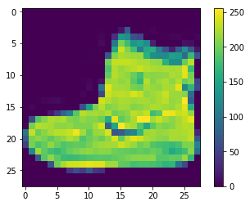
Explore the Data
plt.figure()
plt.imshow(train_images[0])
plt.colorbar()
plt.grid(False)
plt.show()
Notes:
The data must be preprocessed before training the network. If you inspect the first image in the training set, you will see that the pixel values fall in the range of 0 to 255
Image from output of tutorial

Slide 16
Preprocess the Data
train_images = train_images / 255.0
test_images = test_images / 255.0
Notes:
We scale these values to a range of 0 to 1 before feeding to the neural network model. For this, we divide the values by 255. It's important that the training set and the testing set are preprocessed in the same way.

Slide 17
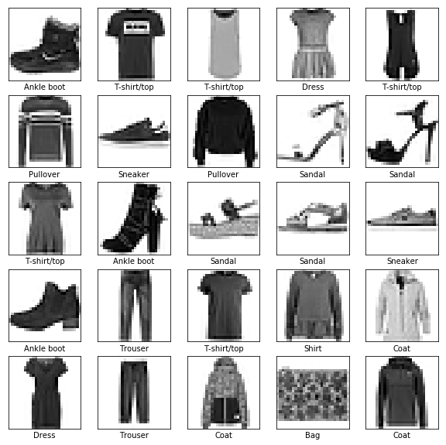
Preprocess the Data
plt.figure(figsize=(10,10))
for i in range(25):
plt.subplot(5,5,i+1)
plt.xticks([])
plt.yticks([])
plt.grid(False)
plt.imshow(train_images[i],
cmap=plt.cm.binary)
plt.xlabel(class_names[train_labels[i]])
plt.show()
Notes:
Display the first 25 images from the training set and display the class name below each image.
Verify that the data is in the correct format and we're ready to build and train the network.
Image from output of tutorial

Slide 18
Ready? Let’s build the model.
Notes:
Building the neural network requires configuring the layers of the model, then compiling the model.

Slide 19
Setup the Layers
ACTIVATED NEURONS
INPUT LAYER
OUTPUT LAYER
Image adapted from becominghuman.ai by Venkatesh Tata
Notes:
The basic building block of a neural network is the layer. Layers extract representations from the data fed into them. And, hopefully, these representations are more meaningful for the problem at hand.
Image adapted from becominghuman.ai by Venkatesh Tata

Slide 20
Setup the Layers
model = keras.Sequential([
keras.layers.Flatten(input_shape=(28, 28)),
keras.layers.Dense(128, activation=tf.nn.relu),
keras.layers.Dense(10, activation=tf.nn.softmax)
])
Notes:
Most of deep learning consists of chaining together simple layers. Most layers, like tf.keras.layers.Dense, have parameters that are learned during training.
Can you explain what happens in that code?
The first layer in this network, tf.keras.layers.Flatten, transforms the format of the images from a 2d-array (of 28 by 28 pixels), to a 1d-array of 28 * 28 = 784 pixels. Think of this layer as unstacking rows of pixels in the image and lining them up. This layer has no parameters to learn; it only reformats the data.
After the pixels are flattened, the network consists of a sequence of two tf.keras.layers.Dense layers. These are densely-connected, or fully-connected, neural layers. The first Dense layer has 128 nodes (or neurons). The second (and last) layer is a 10-node softmax layer—this returns an array of 10 probability scores that sum to 1. Each node contains a score that indicates the probability that the current image belongs to one of the 10 classes.

Slide 21
Compile the Model
model.compile(optimizer='adam',
loss='sparse_categorical_crossentropy',
metrics=['accuracy'])
Notes:
Can you explain about the component on model.compile?
Before the model is ready for training, it needs a few more settings. These are added during the model's compile step:
Optimizer —This is how the model is updated based on the data it sees and its loss function.
Loss function —This measures how accurate the model is during training. We want to minimize this function to "steer" the model in the right direction.
Metrics —Used to monitor the training and testing steps. The following example uses accuracy, the fraction of the images that are correctly classified.

Slide 22
Train the Model
model.fit(train_images, train_labels, epochs=5)
Notes:
Training the neural network model requires the following steps:
Feed the training data to the model—in this example, the train_images and train_labels arrays.
The model learns to associate images and labels.
We ask the model to make predictions about a test set—in this example, the test_images array. We verify that the predictions match the labels from the test_labels array.
To start training, call the model.fit method—the model is "fit" to the training data.

Slide 23
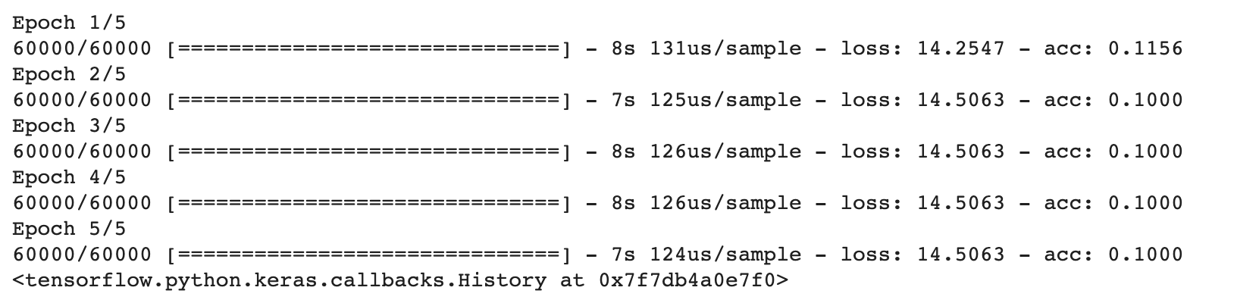
Train the Model - Output
Notes:
Can you explain about this result? What does it means?
As the model trains, the loss and accuracy metrics are displayed. This model reaches an accuracy of about 0.88 (or 88%) on the training data.

Slide 24

Evaluate accuracy
test_loss, test_acc = model.evaluate(test_images,
test_labels)
print('Test accuracy:', test_acc)
Notes:
Next, compare how the model performs on the test dataset
What is your conclusion from this test?
It turns out, the accuracy on the test dataset is a little less than the accuracy on the training dataset. This gap between training accuracy and test accuracy is an example of overfitting. Overfitting is when a machine learning model performs worse on new data than on their training data.

Slide 25
Make Predictions
predictions = model.predict(test_images)
predictions[0]
Notes:
With the model trained, we can use it to make predictions about some images.
A prediction is an array of 10 numbers. These describe the "confidence" of the model that the image corresponds to each of the 10 different articles of clothing. We can see which label has the highest confidence value:

Slide 26
Check which Label has the Highest Confidence Value
np.argmax(predictions[0])
test_labels[0]
Notes:
What is the result?
A prediction is an array of 10 numbers. These describe the "confidence" of the model that the image corresponds to each of the 10 different articles of clothing. We can see which label has the highest confidence value:
The model is most confident that this image is an ankle boot, or class_names[9]

Slide 27
Visualize the Data Function (1 of 3)
def plot_image(i, predictions_array, true_label, img):
...
def plot_value_array(i, predictions_array, true_label):
...
Notes:
Code shrunken down to fit on slide. There isn't anything to go through here.

Slide 28
Visualize the Data Function (2 of 3)
i = 0
plt.figure(figsize=(6,3))
plt.subplot(1,2,1)
plot_image(i, predictions, test_labels, test_images)
plt.subplot(1,2,2)
plot_value_array(i, predictions, test_labels)
plt.show()
Notes:
Let's look at the 0th image, predictions, and prediction array.
What is the result? Can you check the 12th image prediction?

Slide 29
Visualize the Data Function (3 of 3)
num_rows = 5
num_cols = 3
num_images = num_rows * num_cols
plt.figure(figsize=(2 * 2 * num_cols, 2 * num_rows))
for i in range(num_images):
plt.subplot(num_rows, 2 * num_cols, 2 * i + 1)
plot_image(i, predictions, test_labels, test_images)
plt.subplot(num_rows, 2 * num_cols, 2 * i + 2)
plot_value_array(i, predictions, test_labels)
plt.show()
Notes:
Let's plot several images with their predictions.
Correct prediction labels are blue and incorrect prediction labels are red.
The number gives the percent (out of 100) for the predicted label. Note that it can be wrong even when very confident.

Slide 30
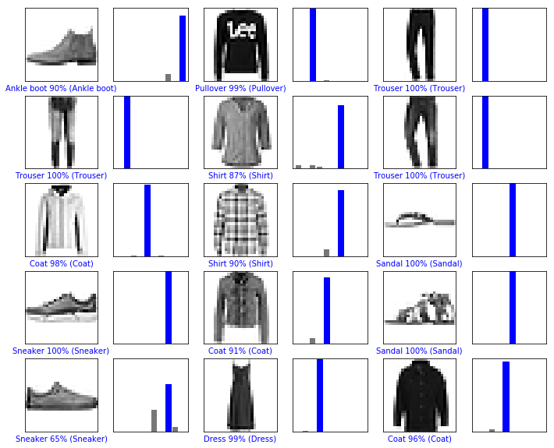
What Result did You Get?
Notes:
Image from output of tutorial

Slide 31
Predict on a Single Image (1 of 2)
img = test_images[0]
print(img.shape)
img = (np.expand_dims(img, 0))
print(img.shape)
Notes:
tf.keras models are optimized to make predictions on a batch, or collection, of examples at once. So even though we're using a single image, we need to add it to a list

Slide 32
Predict on a Single Image (2 of 2)
predictions_single = model.predict(img)
print(predictions_single)
plot_value_array(0, predictions_single, test_labels)
plt.xticks(range(10), class_names, rotation=45)
plt.show()
Notes:
model.predict returns a list of lists, one for each image in the batch of data. Grab the predictions for our (only) image in the batch.
What is the result?

Slide 33
Check the Prediction Result
prediction_result = np.argmax(predictions_single[0])
print(prediction_result)
Notes:
And, as before, the model predicts a label of 9.

